Slide 1
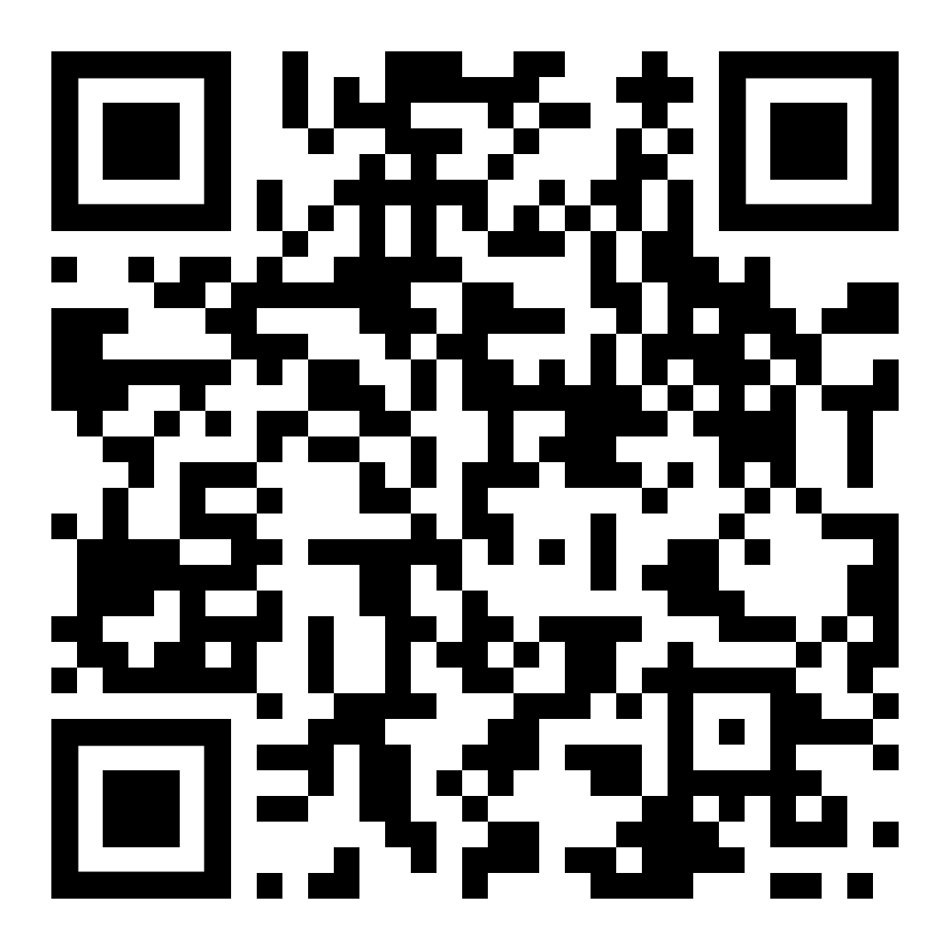

CTA - Digital CS Kiosk/ SMARTCS
SCAN HERE
For More Information
For Inquiry,
Please Contact Us at:

Slide 2
CTA – Tablet Solutions for Service Preparation Area
SCAN HERE
For More Information
For Inquiry,
Please Contact Us at:

Slide 3
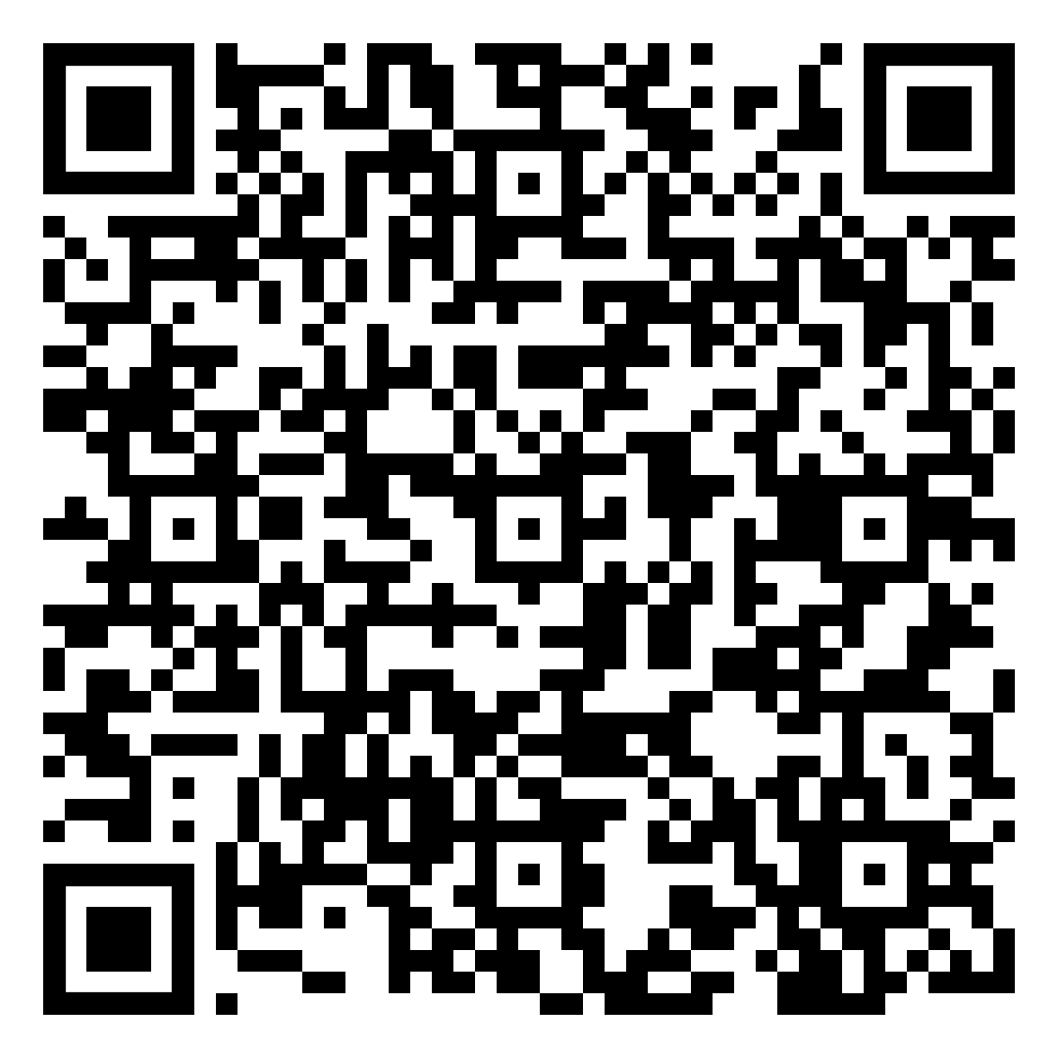
CTA – Robotic Monitor Arm
SCAN HERE
Secure the Best Price
For More Information,
Please Contact Us at:

Slide 4
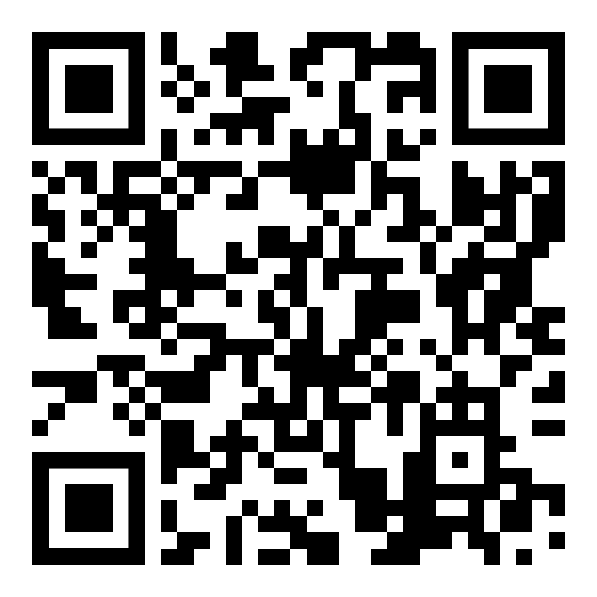
CTA – Multi-denom CDM
SCAN HERE
Secure the Best Price
For More Information,
Please Contact Us at:

Slide 5
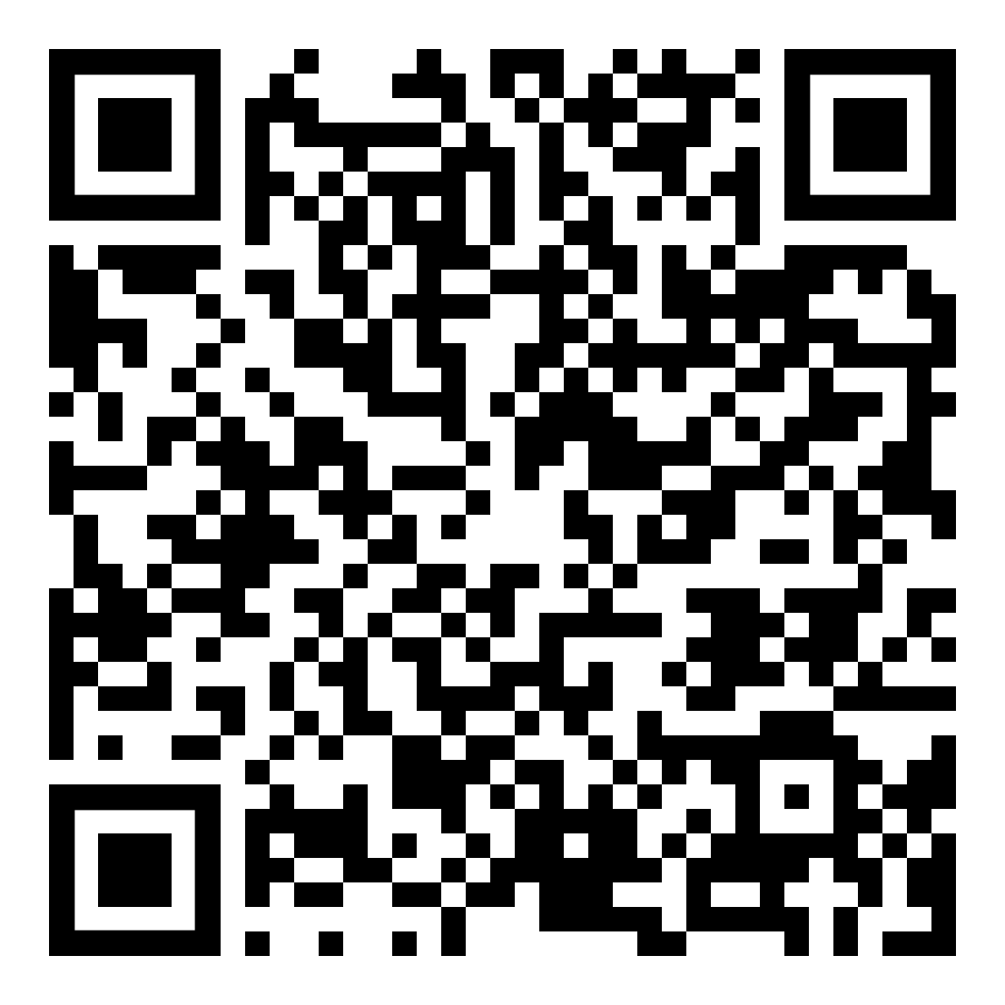
CTA – Multicurrency Money Counting Machine
SCAN HERE
For More Information
For Inquiry,
Please Contact Us at:

Slide 6
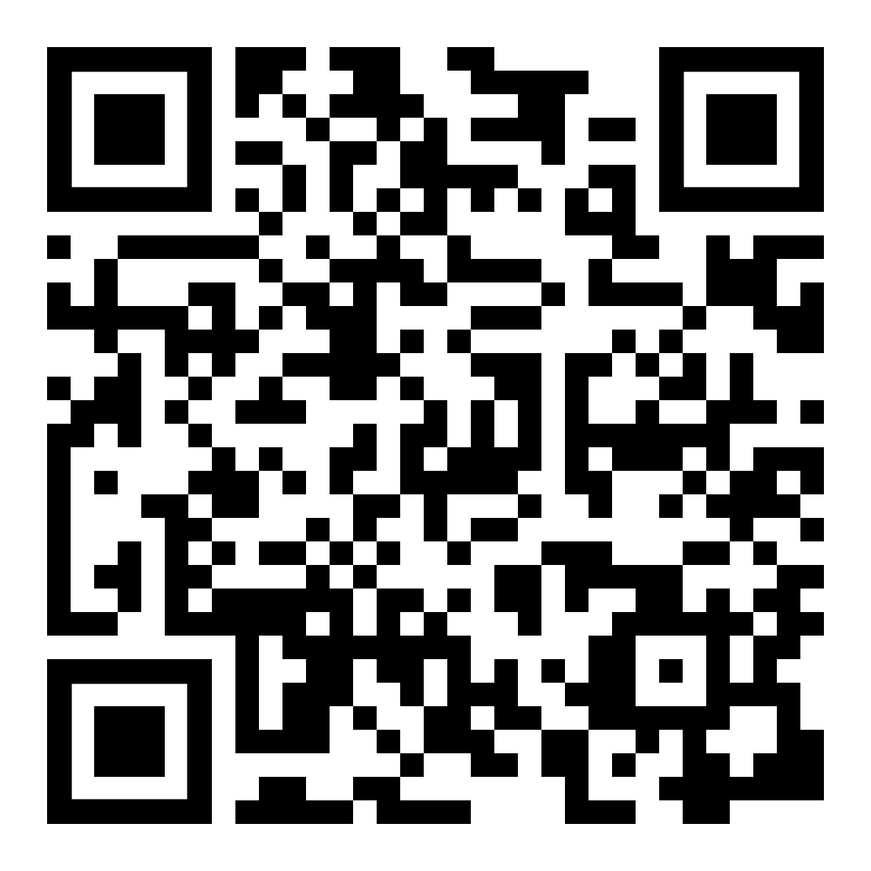
CTA – Digital Menu Board
SCAN HERE
For More Information
For Inquiry,
Please Contact Us at:

Slide 7
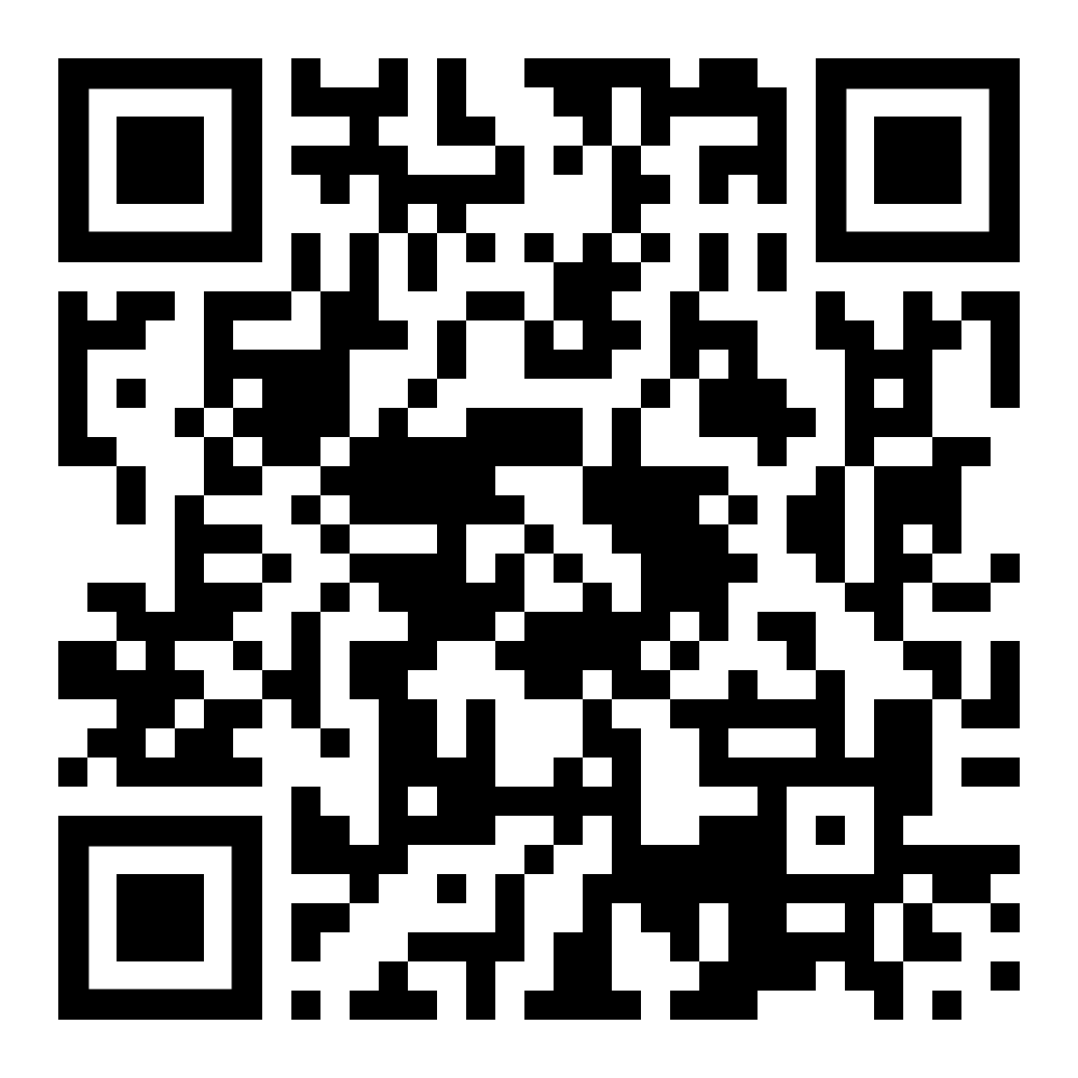
CTA – Digital Poster & Banner
SCAN HERE
For More Information
For Inquiry,
Please Contact Us at:

Slide 8
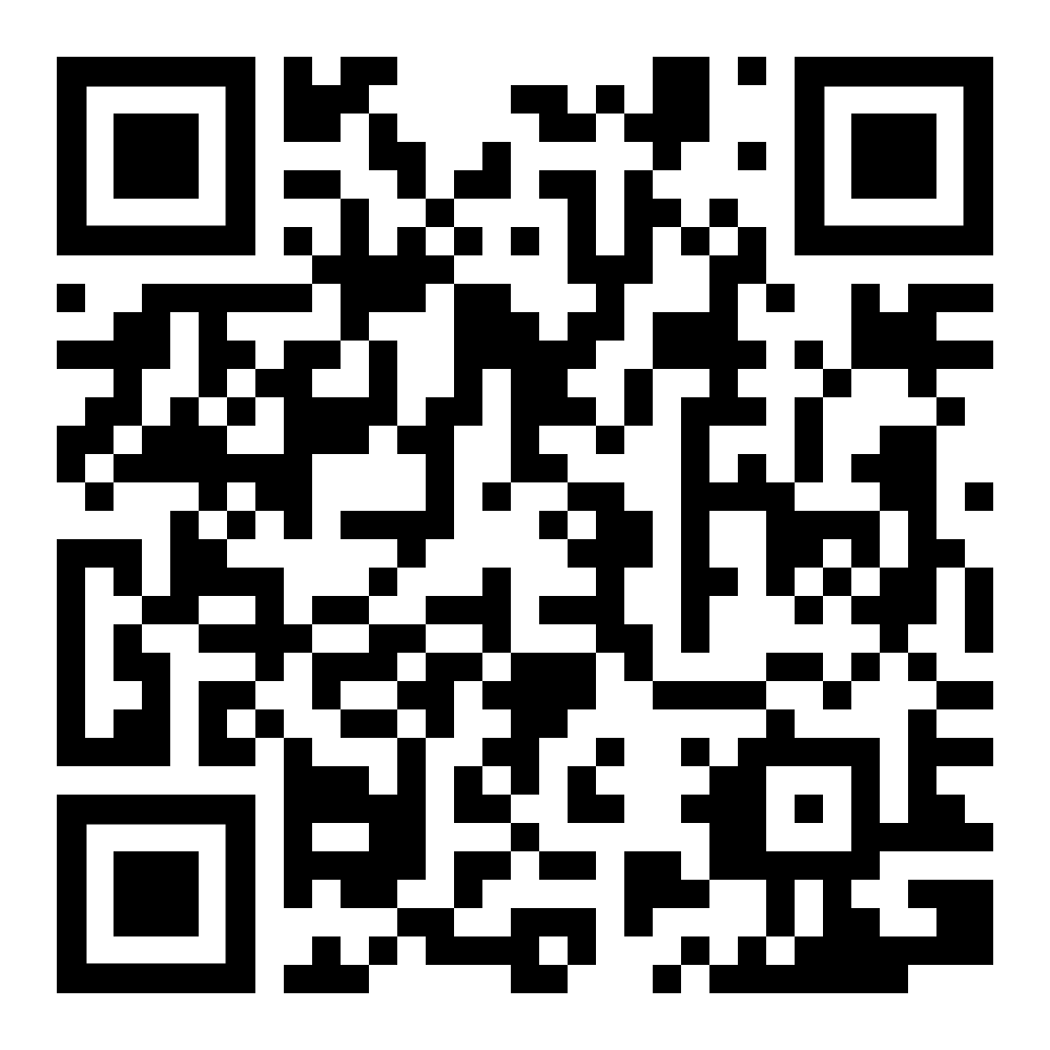
CTA – LCD Price Tags
SCAN HERE
For More Information
For Inquiry,
Please Contact Us at:

Slide 9
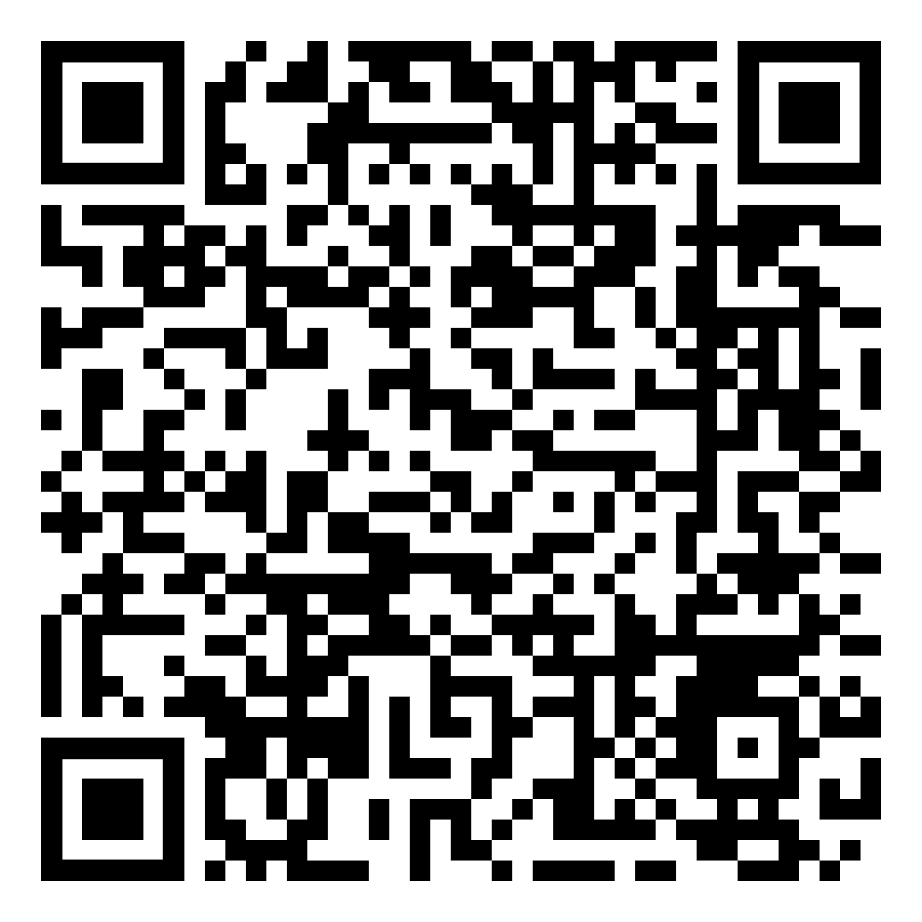
CTA – Self-service Price Checker
SCAN HERE
For More Information
For Inquiry,
Please Contact Us at:

Slide 10
CTA – Self-service Ordering Kiosk
SCAN HERE
For More Information
For Inquiry,
Please Contact Us at:

Slide 11
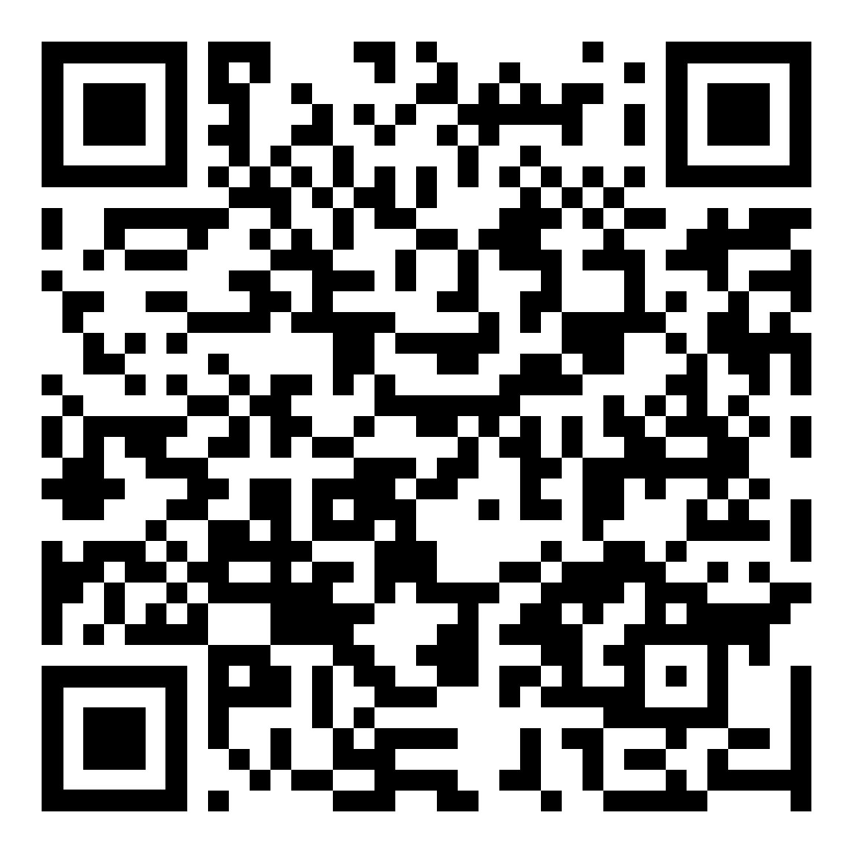
CTA – Interactive Robot Greeter & Assistant
SCAN HERE
For More Information
For Inquiry,
Please Contact Us at:

